Slide 1
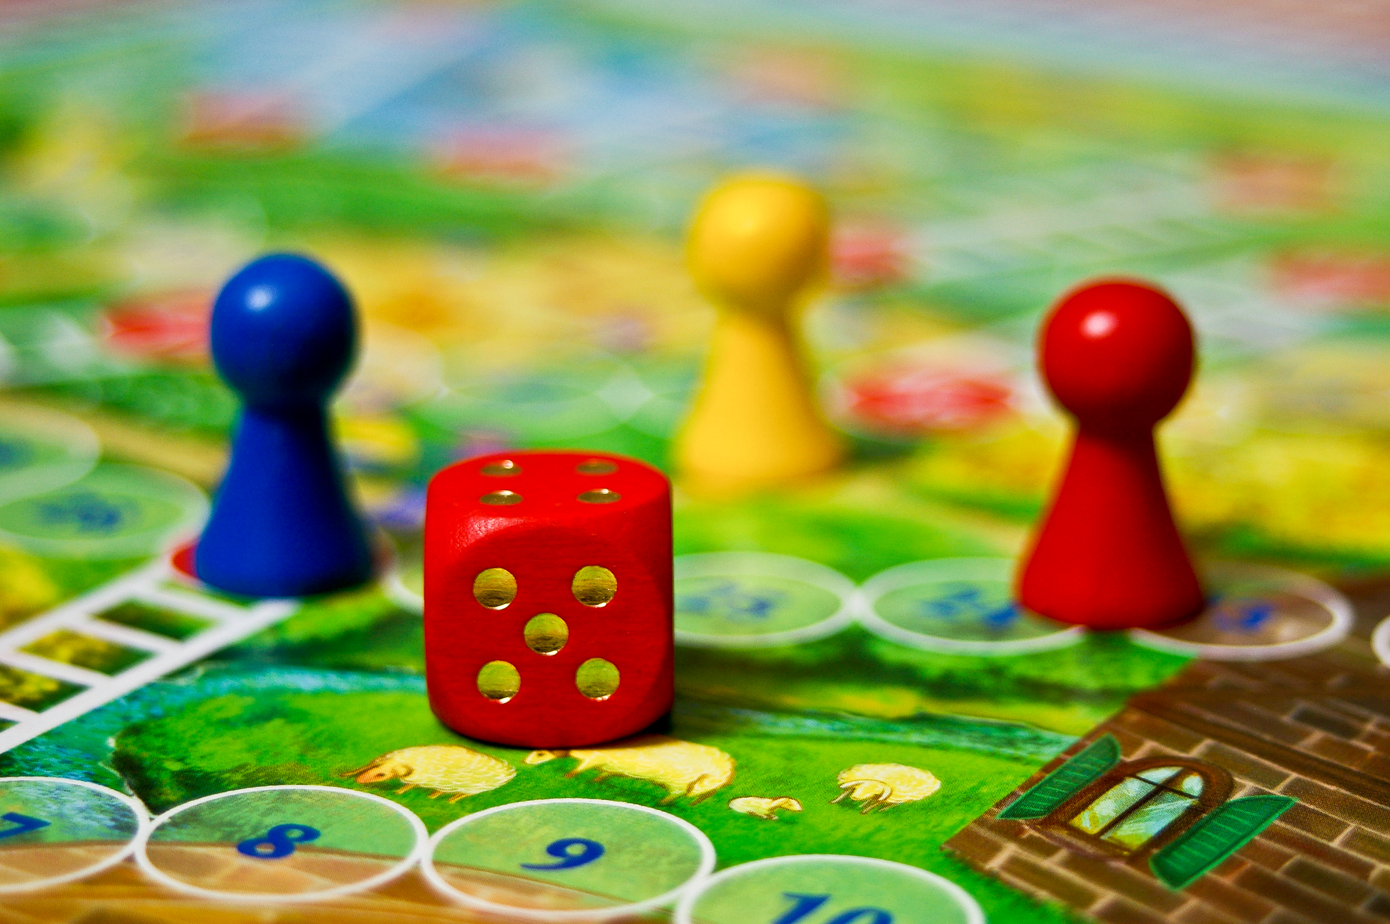
Game Library Project
By MYCHAL CLARK
SPRING 2022

Slide 2

WHY and What?
Why Did I take on this project?
For a grade
First time with java
What Did I learn from this project?
Mobile Development
Java
What Would I do differently next time?
More features

Slide 3
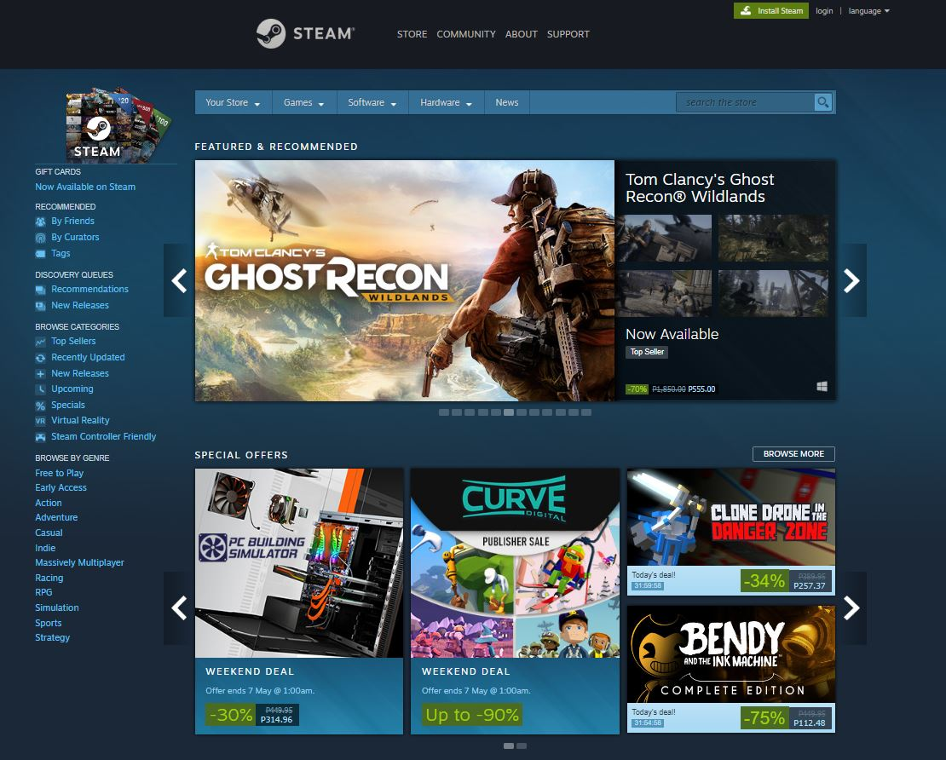
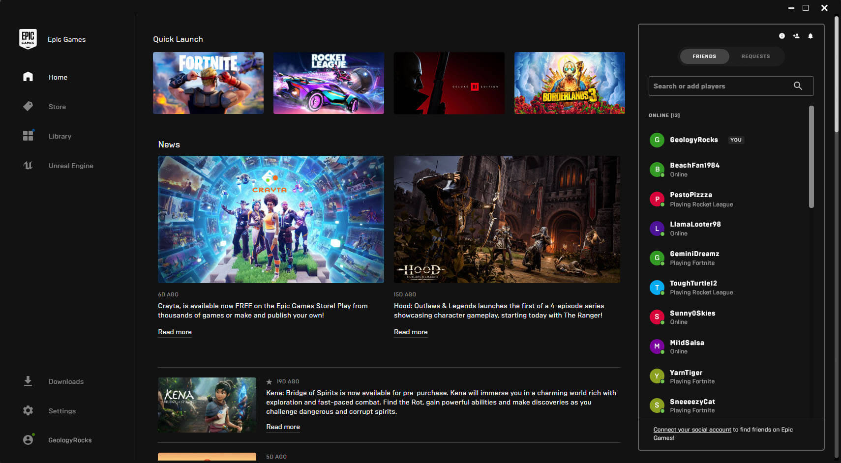
Similar Applications
Steam
Epic games

Slide 4
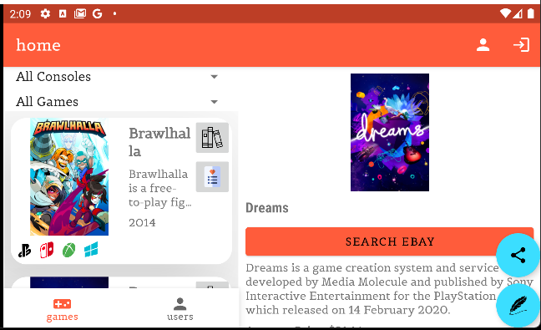
Key features
Comments
For user engagement.
Voice your opinion
Game List
UI to show off games.
Easy accessibility
Accounts
Stores user information
Personalized space

Slide 5
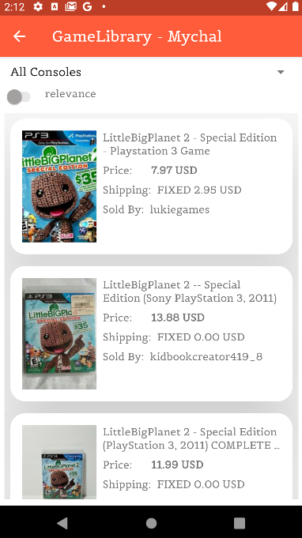
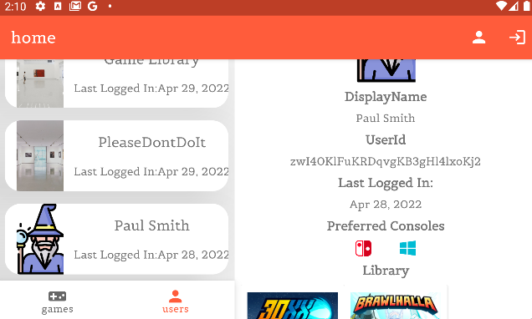
Pictures

